Slide 1

C++ programming - Backend
Trainer: Vo Thang Loi, Associate Software Manager - WTE

Slide 2

Content
Apache thrift
POCO C++ libraries
SWIG
Autotest framework

Slide 3

1. Apache thrift

Slide 4
Apache thrift
Introduction
Components
  Types
  Transport and protocol layer
  Processors and servers
Thrift anatomy
Thrift flow
Available projects
  Zing Me
Example
Problems
Homework
References

Slide 5
Apache thrift - Introduction
Remote Procedural Call (RPC) Framework for developing scalable cross platform/language services.
Supports: C++, Java, Python, PHP, C#, Go, Erlang, Ruby, ObjC, Perl, Haskell, Cocoa, JavaScript, Node.js, Smalltalk, Squeak, OCaml and more...
Developed internally at Facebook. Open sourced in April 2007
Entered Apache Inbubation in May 2008
Allows you to quickly define your service.
Compiles client and server wrappers for your calls.
Takes care of everything for you, and makes all the networking, serialization, etc... transparent.
Firing up a server is literally <20 lines of code.

Slide 6
Apache thrift - Components
Type system
  Generic Type System compatible with all languages.
Transport layer
  Actual data transfer over stream sockets/HTTP etc.
Protocol layer
  Encoding/Decoding of data types
Processors
  Encapsulates logic of reading/writing to input/output streams
Servers
  Wrapper over all above layers for the server end

Slide 7
Apache thrift - Types
Define your data types in a Thrift Interface Description File (*.thrift)
Base Types:
  bool
  byte
  i16, i32, i64
  double
  string
Struct : C style structures (struct)
Containers: list, set, map
Reference: include “shared.thrift”
Exception: Basically structs (exception, throws)
Services: Interfaces defining the remote methods. Equivalent to an abstract class (service)
Others: namespace, typedef, const, enum, void, oneway, extends, ...

Slide 8
Apache thrift – Transport layer
Type system
Abstracts out the logic of reading/writing over the communication layer through Interfaces
Decouples the remaining system from nitty-gritty of raw data transfer
TTransport Interface :
  open, close, isOpen, read, write, flush
TServerTransport Interface:
  open, listen, accept, close
Available Implementation :
  TSocket, TFileTransport, TframedTransport, TBufferedTransport, TserverSocket, etc ...

Slide 9
Apache thrift – Protocol layer
Abstracts out the serialization and deserialization of data types
Exposes read/write methods for all data types
Implementations:
  Binary
  Compact
  JSON
  Plain Text, XML

Slide 10
Apache thrift – Processors
TProcesser interface handles the reading and writing of data through TProtocol objects.
Invokes the user implemented handlers for remote methods

Slide 11
Apache thrift – Servers
Encapsulates all the above layers:
  Creates transport
  Creates protocols for the transport
  Creates a processor based on the input/output protocols
  Listen for incoming connections and pass them to the processor
  Server types: TSimpleServer, TthreadedServer, TthreadPoolServer, TnonBlockingServer, ThttpServer, TforkingServer, TProcessPoolServer

Slide 12
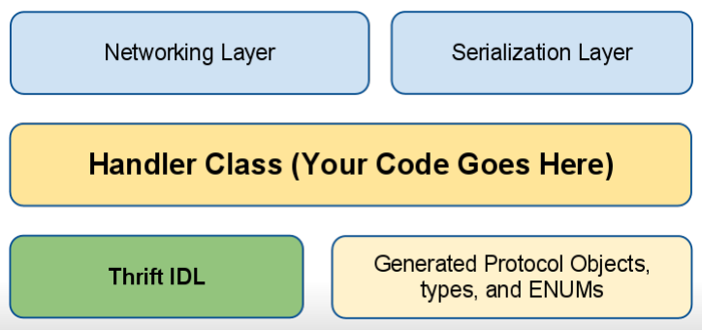
Apache thrift – Anatomy

Slide 13
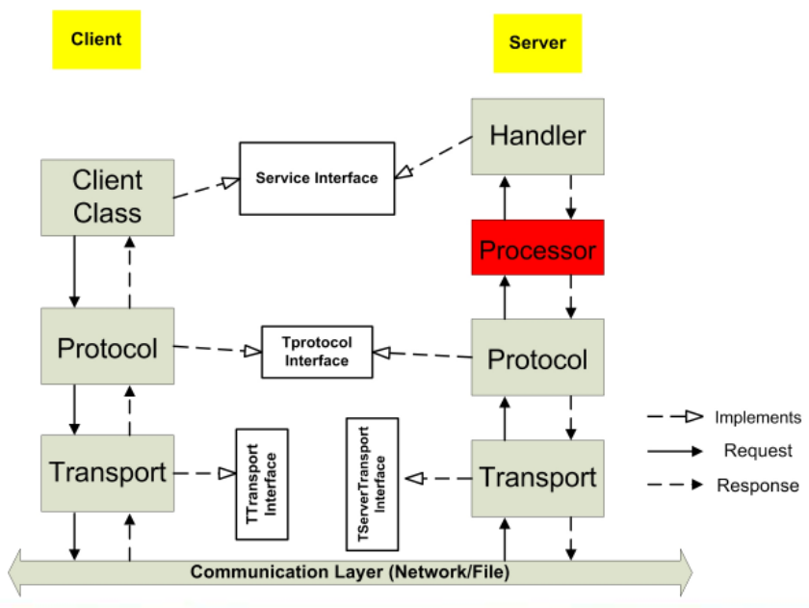
Apache thrift – Whole Flow

Slide 14
Apache thrift – Projects
Cassandra
ThriftDB
Hadoop / Hbase
Facebook
Zing Me

Slide 15
Apache thrift – Zing Me
Zing Me description

Slide 16
Apache thrift – Example
“Hello world” service: (hello_world.thrift)
  namespace cpp HelloWorld
  service HelloWorld {
  void sayHelloWorld()
  }
Generating server code:
  thrift --gen cpp hello_world.thrift
Implementing the server
  Modify the generated file “HelloWorld_server.skeleton.cpp”
  Use TNonBlockingServer
Compiling and building the server
  g++ -Wall -I/usr/local/include/thrift *.cpp -lthrift -o helloworld
  g++ -L/usr/local/lib *.o -o HelloWorldServer -lthrift
Implementing a client for HelloWorldServer
  Using generated client interface HelloWorldClient

Slide 17
Apache thrift – Problems
IDL Limits:
  No circular references
  No returning NULLs
  No inheritance
No out-of-the-box authentication.
No bi-directional messaging.
In thread-pool mode, you are limited to N connections
Make your workers either very fast, or async, to avoid choking the server.
In Python, GIL problem means thread based servers suck.
Make sure you get the right combination of transports on client and server.
Make sure to use binary serializers when possible.

Slide 18
Apache thrift – Homework
Using Thrift to implement a ViewCount project:
  Count a number of visitors of websites
  Each visit will increase the number of view by 1
  Allow administrator to decrease the number of view of a specific website
  Allow administrator to set a certain value to the number of view of a specific website
  Add extra functions for ViewCount server if needed

Slide 19
Apache thrift – References
Thrift Whitepaper:
  http://thrift.apache.org/static/thrift-20070401.pdf
Thrift Wiki:
  http://en.wikipedia.org/wiki/Apache_Thrift
Thrift API:
  http://people.apache.org/~jfarrell/thrift/0.7.0/javadoc/
Thrift: The Missing Guide:
  http://diwakergupta.github.com/thrift-missing-guide/

Slide 20
2. POCO C++ libraries

Slide 21
POCO
Introduction
Features
Objectives and Mission
Principles
Supported platforms
Benefits
Libraries

Slide 22
POCO - Introduction
A collection of C++ class libraries, similar in concept to the Java Class Library, the .NET Framework or Apple's Cocoa
Focused on "internet-age" network-centric applications
Written in efficient, modern ANSI/ISO Standard C++ and based on the C++ Standard Library/STL
Highly portable and available on many different platforms
Open Source, licensed under the Boost Software License, and thus completely free for both commercial and non-commercial use.
History: started in summer 2004 by Günter Obiltschnig, first release on SourceForge in Feb 2005, first contribution by Aleksandar Fabijanic in May 2005, moved to Boost license in July 2006, stable release in July 2010

Slide 23
POCO - Features
Any and DynamicAny classes
Cache framework
Cryptography (cryptographic hashes, encryption based on OpenSSL)
Date and Time classes
Events (signal/slot mechanism) and notifications framework
FTP client for transferring files
Filesystem classes for platform-independent path manipulation, directory listing and globing
HTML form handling

Slide 24
POCO - Features
HTTP server and client (also secure), C++ Server Page Compiler
Logging framework
Multithreading: basic threads and synchronization and advanced facilities (thread pool, active objects, work queues, etc.)
POP3 client for receiving mail
Platform Abstraction: write once, compile and run on multiple platforms
Processes and IPC
Reactor framework
Regular expressions (based on PCRE)

Slide 25
POCO - Features
SMTP client for sending mail
SQL database access (SQLite, MySQL, ODBC)
SSL/TLS support based on OpenSSL
Shared library and class loading
Smart pointers and memory management (buffer, pool)
Sockets and raw sockets
Stream classes for Base64 and HexBinary encoding/decoding, compression (zlib), line ending conversion, reading/writing to memory, etc.

Slide 26
POCO - Features
String formatting and string utilities
TCP server framework (multithreaded)
Text encodings and conversions
Tuples
URI handling
UTF-8 and Unicode support
UUID handling and generation
XML parsing (SAX2 and DOM) and XML generation
Zip file manipulation

Slide 27
POCO - Objectives & Mission
POCO is a powerful, yet easy to use platform to build your applications upon
POCO allows you to build highly portable applications (write once – compile and run anywhere)
POCO is modular and scalable from embedded to enterprise applications (you only pay for what you use)
POCO provides consistent, comprehensive and comprehensible
programming interfaces
POCO is written in fast, efficient C++

Slide 28
POCO - Objectives & Mission
POCO favors simplicity over complexity ("as simple as possible, but not simpler")
POCO aims for consistency in design, coding style and documentation
POCO emphasizes source code quality, in terms of readability, comprehensiveness, consistency, style and testability
POCO aims to make C++ programming fun again

Slide 29
POCO - Principles
Strong focus on code quality, style, consistency and code readability – all code must satisfy our coding style guide (and it works – we frequently get compliments on our code quality)
Strong focus on tests (automated unit tests with high coverage)
Favor pragmatic and elegant design over "solving all the worlds problems" (if we can satisfy 95 % of all use cases with an elegant solution, and the remaining 5 % would require an overly complex design, we focus on the 95 %)
Build on top of solid foundations – use existing proven C libraries (e.g., expat, zlib, PCRE, SQLite) where it makes sense

Slide 30
POCO - Platforms
Microsoft Windows
Linux
Mac OS X
HP-UX, Solaris, AIX*
Embedded Linux (uClibc, glibc)
iOS
Windows Embedded CE
QNX

Slide 31
POCO - Benefits
Comprehensive, complete and mature C++ frameworks that save lots of work and help bringing the product to market sooner.
Easy learning curve through intuitive, consistent and comprehensible programming interfaces, lots of sample code and good documentation.
Native C++ code performance (no VM overhead, etc.), low memory requirements.
Platform independence: write once – compile and run everywhere.
  In many cases, a large part of an application (everything that does not need access to specific hardware) can be tested and debugged on the development host.
  An application can be easily ported to a new platform.

Slide 32
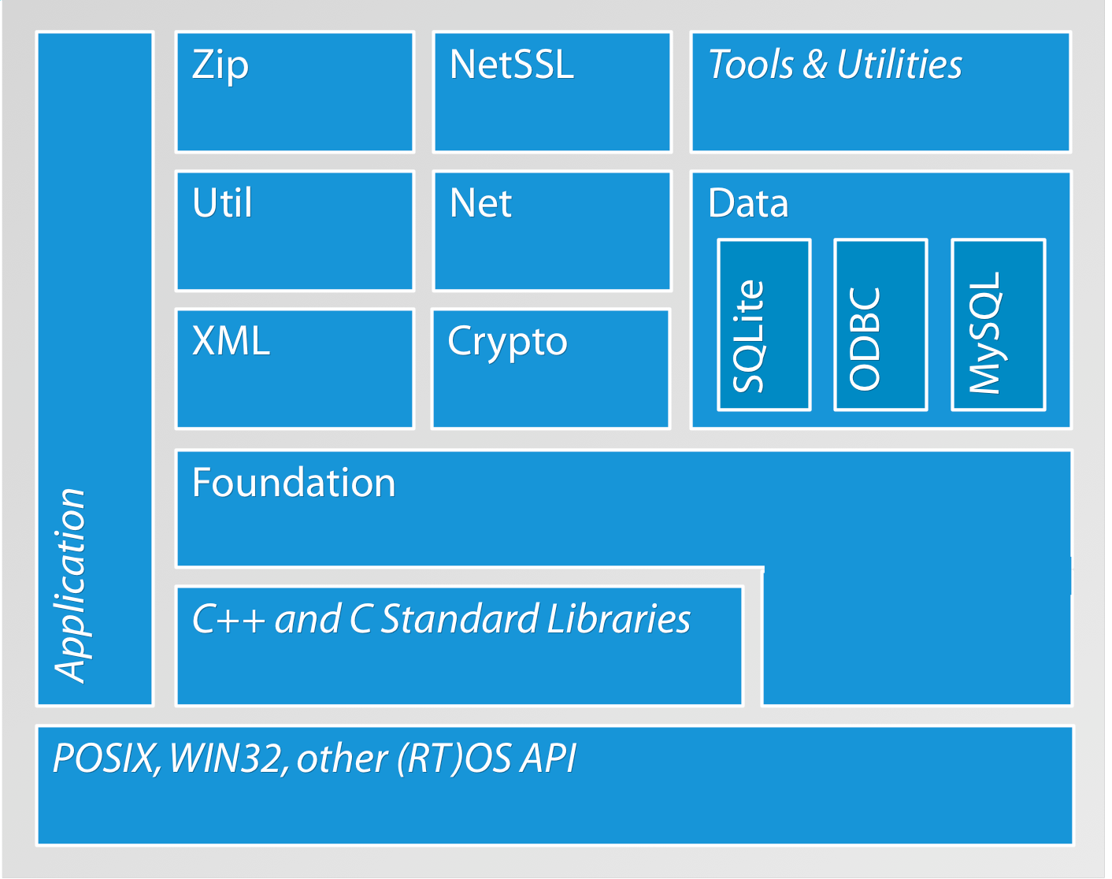
POCO - Libraries

Slide 33
POCO - Libraries
Poco includes 4 main libraries:
  Foundation
  XML
  Util
  Net
We focus on 2 main libraries:
  Foundation
  Util

Slide 34
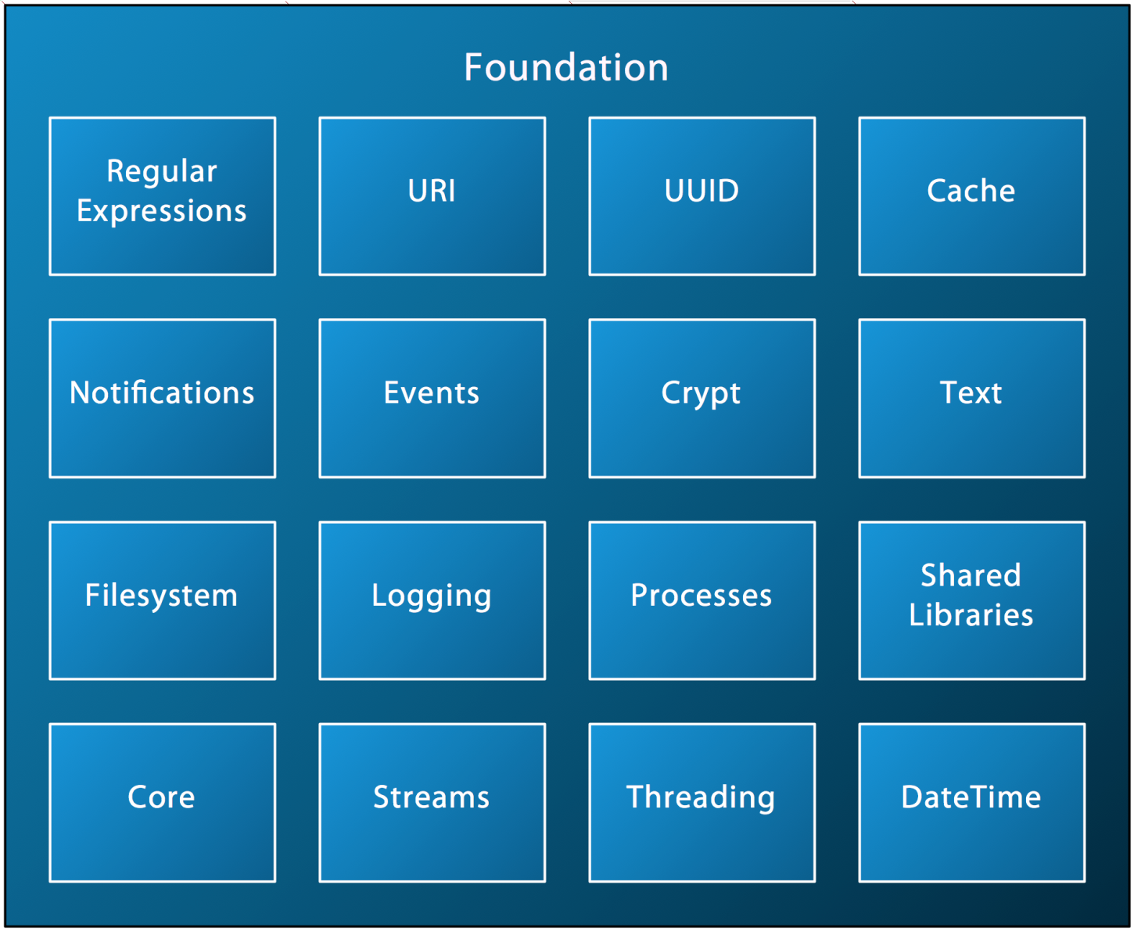
POCO – Foundation

Slide 35
POCO – Foundation
The Foundation library makes up the heart of POCO
Handling types and byte order, error handling and debugging, memory management, handling strings, support for formatting and parsing numbers, handling dates and times, accessing the file system, handling events and notifications, streaming, multithreading, synchronizing, logging, shared libraries
We pay attention to multithreading and caching

Slide 36
POCO – Util
POCO Util library includes the following components:
  Configuration files
  Command line options
  Tools and server applications

Slide 37
POCO – Multithreading
The Thread class
Thread pools
Thread Local Storage
Thread Error Handling
Synchronization
  (Mutex, FastMutex, Event, Condition, Semaphore, RWLock)
Higher-level abstractions
  (Timers, Active Objects, Tasks and Task Management)

Slide 38
POCO – Thread class
Poco::Thread represents a thread in POCO.
#include "Poco/Thread.h"
In POCO, a thread has
  an optional name
  a priority (Thread::Priority)
    [PRIO_LOWEST, PRIO_LOW, PRIO_NORMAL (default), PRIO_HIGH, PRIO_HIGHEST]
  a unique ID (integer)
Poco::Runnable provides an entry point for a thread.

Slide 39
POCO – Runnable class
Poco::Runnable is an interface class for thread entry points.
#include "Poco/Runnable.h"
Subclasses must override the run() method.
The Poco::RunnableAdapter class template can be used to specify an arbitrary no-argument void member function as a thread entry point.
#include "Poco/RunnableAdapter.h"

Slide 40
POCO – Working with threads
start() : start a thread and referenced to a Runnable
join() : wait until the thread terminates, then return
setPriority() : set thread priority
getPriority() : get thread priority
id() : get thread unique numerical id
name() : get thread name
isRunning() : check whether a thread is running
current() : return the pointer to the Thread object of the current thread
sleep(long milliseconds) : suspend the current thread
yield() : give the CPU to another thread

Slide 41
POCO – Thread pools
The creation of a new thread takes some time, and often threads can be reused.
Managing the lifetime of Thread objects can be hard (who deletes the thread when it's done, ...)
You may want to control the number of threads created in your application. A ThreadPool can do that for you.

Slide 42
POCO – ThreadPool class
Poco: ThreadPool implements thread pooling in POCO.
#include "Poco/ThreadPool.h"
A thread pool has a maximum capacity; if the capacity is exhausted, a NoThreadAvailableException is thrown if a new thread is requested.
The capacity of a thread pool can be increased dynamically:
  void addCapacity(int n).
POCO provides a default ThreadPool instance with an initial capacity of 16 threads.
Threads in a thread pool can be started with a specific priority.
A thread pool will collect all threads that have been idle for a certain amount of time.

Slide 43
POCO – Thread local storage
Thread Local Storage is a special kind of variable that has a different value in every thread.
A thread has no way to access the value of another thread.
Type safe Thread Local Storage in POCO is implemented by the
  Poco::ThreadLocal class template.
#include "Poco/ThreadLocal.h"
Poco::ThreadLocal can be instantiated with any class that is default constructible.
To access the actual value of a thread local variable, use the arrow (->) or asterisk (*) operator of ThreadLocal.

Slide 44
POCO – Thread error handling
An unhandled exception in a thread causes the thread to terminate. However, such an unhandled exception is normally not reported to the outside.
It is possible to register a global error handler that gets notified about unhandled exceptions in threads.
Such an error handler must be derived from the Poco::ErrorHandler class.
  (#include "Poco/ErrorHandler.h")

Slide 45
POCO – Thread synchronization
POCO provides the following synchronization primitives:
  Poco::Mutex
  Poco::FastMutex
  Poco::ScopedLock
  Poco::Event
  Poco::Condition
  Poco::Semaphore
  Poco::RWLock

Slide 46
POCO – Higher-level abstractions
Poco::Timer
Poco::Task
Poco::TaskManager
Poco::NotificationCenter
Poco::TaskNotification
Active objects: Poco::Activity
  runs (some of ) its member functions in its/their own thread(s)

Slide 47
POCO – Caching
Motivation
Features
Performance Costs
Memory Costs

Slide 48
POCO – Caching Motivation
STL containers make a good job in allowing you to store data
  But you can't limit the size of the container, a map/set can potentially grow to infinite size
  You can't let elements expire
POCO's caching framework supports exactly that
  Only std::map like behavior is supported so far
  Don't use caching if you don't need these properties (more on that in the "Costs" section)

Slide 49
POCO – Caching Features
POCO's caching framework supports the two most commonly used cache algorithms
  Least Recently Used (LRU)
    Size limited
    Keeps the last accessed elements in cache
  Time based expiration
    Not size limited
    Either with a default time value applied to all entries or a unique time value
  Combinations: LRU combined with expiration

Slide 50
POCO – Caching Performance
A cache is slower than a std::map:
  Cache replacement costs time
Most expensive method: add()
  First search and remove an old entry
  Insert into the AbstractCache
  Then insert into the Strategy
  Do cache replacement
Costs
  All operations are still O(log(n))
  Exact: O((x + numofstrategies) * (log(n))
  i.e. ExpireLRUCache is more expensive than LRUCache
  x:={1, 2} depending on method called

Slide 51
POCO – Caching Memory
AbstractCache without strategy requires approx. The same memory as a std::map; overhead is one SharedPtr object per entry.
Additional overhead per strategy:
  Each must store the keys at least
Strategies are optimized for speed not memory. Typically, you need two different views on the keys so you can guarantee O(log(n)), otherwise you would end up with O(n).
Memory per entry
  Base costs: sizeof(TKey)+sizeof(TVal)

Slide 52
POCO – Application
Applications Introduction
Application Subsystems
Command Line Applications
Server Applications
Command Line Option Handling
Configuration
Logger

Slide 53
POCO – Application
The application frameworks in POCO support features needed in virtually every application:
  Command line arguments processing
  Configuration files
  Initialization and shutdown
  Logging
POCO supports two kinds of applications:
  Command line applications
  These are tools normally invoked from the command line
  Server applications
  These are applications that typically run as daemons or Windows services (but can also be ran from the command line)

Slide 54
POCO – Application Subsystem
An application can consist of different subsystems.
Subsystems extend applications in a modular way.
Subsystems help with the initialization and shutdown of an application.
When an application is initialized/shutdown, all of its registered subsystems are initialized/shutdown as well.

Slide 55
POCO – Application Subsystem
Command line applications are implemented by creating a subclass of Poco::Util::Application.
Application is a subclass of Subsystem.
There are a few virtual member functions to override.
  void initialize(Application& self ), void reinitialize()
  void uninitialize(), void defineOptions()
int main(const std::vector<std::string>& args)
Implements the main logic of the application. The args vector contains all command line arguments that have not been processed as options. Should return the exit code of the application, which can be a value from the ExitCode enumeration (e.g., EXIT_OK, EXIT_USAGE, etc.).

Slide 56
POCO – Server Application
Server applications are implemented by creating a subclass of Poco::Util::ServerApplication (which is a subclass of Poco::Util::Application).
Server applications can be ran from the command line, as a Windows service, or a Unix daemon.
Normally, a server application does its work in a background thread. Therefore, the main() member function will launch the thread, and then wait for an external request to terminate the application (see waitForTerminationRequest()).

Slide 57
POCO – App. Option Handling
Applications can define and handle command line arguments (options).
Command line arguments are usually specified in the format typical for the platform:
  /option or /option=value on Windows
  -o, -ovalue, --option or --option:value on Unix
Options are defined by adding them to the application's OptionSet, using the OptionSet::addOption() member function.
Defining options is done by overriding the virtual defineOptions() member function.
To handling options, an option can be bound to a configuration property.
A callback member function can be specified for handling an option.
The option can be handled in the application's handleOption() member function.
The Poco::Util::HelpFormatter class can be used to display command line options help information.

Slide 58
POCO – Application Configuration
Configuration settings are basically key/value pairs, where both key and value are strings.
An application named APP searches during startup for files named APP(d).{xml,ini,properties}
  Poco::Util::AbstractConfiguration
  Poco::Util::IniFileConfiguration
  Poco::Util::PropertyFileConfiguration
  Poco::Util::XMLConfiguration
LayeredConfiguration: allows layering of multiple configurations according to priority (lower first)

Slide 59
POCO – Application Logger
Poco::Logger is the main entry point into the logging framework.
Every Poco::Logger (which itself is a subclass of Poco::Channel) is connected to a Poco::Channel.
A subclass of Poco::Channel is responsible for delivering messages (Poco::Message) to their destination (e.g., the console or a log file).
POCO provides various subclasses of Poco::Channel that deliver messages to the console, log files or the system's logging facility.
Logger architecture:
  Message → Logger → Channel → Log file
  Message (Logger) → Channel → Log file
  Logger → Message (Channel) → Log file
  Logger → Channel → Message (Log file)

Slide 60
POCO – Homework
Using Poco to implement the ViewCount project:
  Convert the ViewCount project implemented by Thrift into Poco formation. Using Poco main macro.
  Using .properties file to store configuration of the project.
  Using Poco::Logger to log all message generated by the ViewCount project.
  Using Poco to define options in run modes.
  Apply Poco into other necessary areas.

Slide 61
POCO - References
POCO documents:
  http://pocoproject.org/documentation/index.html

Slide 62
3. SWIG

Slide 63
SWIG
Introduction
Overview
Scripting language
SWIG with C++
SWIG with PHP
Limitation
Homework
Reference

Slide 64
SWIG - Introduction
SWIG: Simplified Wrapper and Interface Generator, an easy-to-use tool for integrating scripting languages with C and C++
Compiles ANSI C/C++ declarations into bindings to interpreted languages
Supports most C/C++ datatypes
Simple C++ classes
Run-time type checking
Multiple files and modules
Automatically generates documentation
Use SWIG for prototyping and experimentation
Particularly well-suited for research applications
Language independence and flexibility
Provide a parser and primitives. Allow everything else to be redefined.
Currently supports Tcl, Python, Perl5, Perl4, Guile3, Php

Slide 65
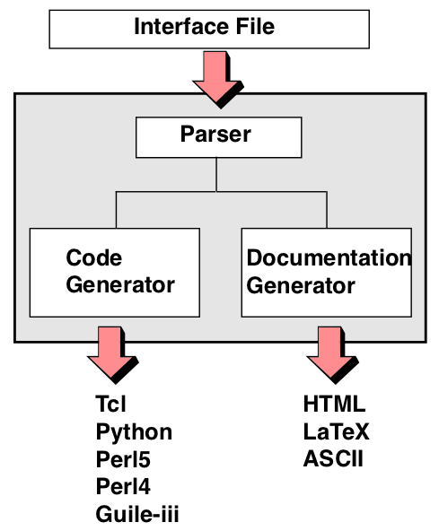
SWIG - Overview
Interface file with
ANSI C/C++
Generic parser
Target languages
implemented as
C++ classes
Easy to extend
(well mostly)
Produces C/C++ source
file as output.
Php

Slide 66
SWIG – Scripting language
All C/C++ built-in datatypes
  int, short, long, char, float, double, void
C/C++ pointers (used for everything else)
Pointers represented as character strings
Pointers are type-checked at run-time
Wrapping a C/C++ function
Linking with a global variable
Creating a constants
Most “typical” C declarations can be handled.

Slide 67
SWIG – With C++
Simple C++ classes and structs
Constructors, destructors, and virtual functions
Single public inheritance
C++ politely turned into C and wrapped (for now)
SWIG provides direct access to C/C++ variables, functions, constants, and classes.
Requires minimal or no code modifications
Can control existing C/C++ applications at a function level

Slide 68
SWIG – With PHP
SWIG supports generating wrappers for PHP5
Generating PHP Extensions
  swig -php example.i
  gcc `php-config --includes` -fpic -c example_wrap.c
  gcc -shared example_wrap.o -o example.so
Using PHP extensions
  php.ini : extension=/path/to/example.so
  dl("/path/to/example.so"); // Load the module
  include("example.php");
Basic PHP interface
  Constants
  Global variables
  Functions
  Overloading
  Pointers and References
  Structures and C++ classes
  PHP Pragmas, Startup and Shutdown code

Slide 69
SWIG - Limitation
C++ support is incomplete (and will probably always be so)
No exception model
Numerical representation problems
(particularly unsigned integers and longs)
No variable or optional arguments
SWIG is still too difficult to extend

Slide 70
SWIG - Homework
Create a PHP extension of the ViewCount project
  Create dynamic library ViewCount.so
  Create PHP interface allowing users access ViewCount service from PHP site.

Slide 71
SWIG - Reference
SWIG : An Easy to Use Tool for Integrating Scripting Languages with C and C++
David M. Beazley - Department of Computer Science University of Utah, Salt Lake City, Utah 84112 - beazley@cs.utah.edu - July 12, 1996

Slide 72
4. Autotest framework

Slide 73
Autotest framework
Introduction
Homework

Slide 74
Autotest framework - Introduction
Logic tests
  Implement test cases of all functions in a service.
Benchmark tests
  Measure execution time of all functions implemented in Logic tests
Load tests
  Access the performance of a service.

Slide 75
Autotest framework - Homework
Write an AutoTest application for the ViewCount project including the following tests
  Logic tests
  Benchmark tests
  Load tests

Slide 76


Slide 77


